Slide 1

Operation Analytics and Investigating Metric Spike
Pintu Kumar Kushwaha

Slide 2

CONTENTS
Project Description
Approach
Tech-Stack Used
Case Study 1 (Job Data)
Case Study 2 (Investigating metric spike)
Result

Slide 3
Project Description
Project Description
The project is about operation analytics and investigating metric spikes for a company using advanced SQL. As a Data Analyst Lead for the company, I have provided with different data sets and tables, which i will use to derive insights and answer questions asked by different departments. I have to focus on two case studies in this project, the first one being job data, and the second one being user engagement and growth.
Operation Analytics is the analysis done for the complete end to end operations of a company. With the help of this, the company then finds the areas on which it must improve upon.
Being one of the most important parts of a company, this kind of analysis is further used to predict the overall growth or decline of a company’s fortune. It means better automation, better understanding between cross-functional teams, and more effective workflows.
In this project we have provided with different data sets, tables from which you must derive certain insights out of it and answer the questions asked by different departments.

Slide 4
Approach
In this project we will start by creating a database and tables using the provided data sets. We will bench.imporThen we will use SQL queries to perform analysis and answer the questions asked in each case study. We will use different SQL functions and techniques to calculate metrics such as the number of jobs reviewed, throughput, percentage share of each language, user engagement, user growth, weekly retention, and email engagement metrics. Finally, we will present our findings and insights in a report to the leadership team.
In this project we have required to provide to provide a detailed report on following two operation
Case Study 1 (Job Data)
Case Study 2 (Investigating metric spike)

Slide 5



Tech-Stack Used
In this project we will use Microsoft Excel, MySQL workbench to compete the entire project.
MySQL Workbench: It is used to create database and writing SQL commands to query database.
Excel: It is used to visualize the data and create charts and graphs.

Slide 6
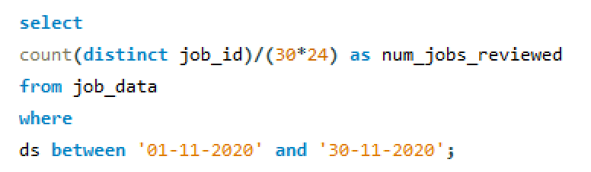
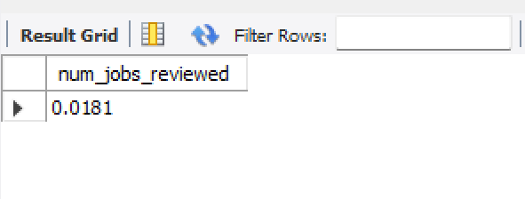
Case Study 1 (Job Data)
Below is the structure of the table with the definition of each column that you must work on:
Table-1: job_data
job_id: unique identifier of jobs
actor_id: unique identifier of actor
event: decision/skip/transfer
language: language of the content
time_spent: time spent to review the job in seconds
org: organization of the actor
ds: date in the yyyy/mm/dd format. It is stored in the form of text and we use presto to run. no need for date function
Insight
Number of jobs reviewed
Calculate the number of jobs reviewed per hour per day for November 2020?
QUERY
OUTYPUT

Slide 7
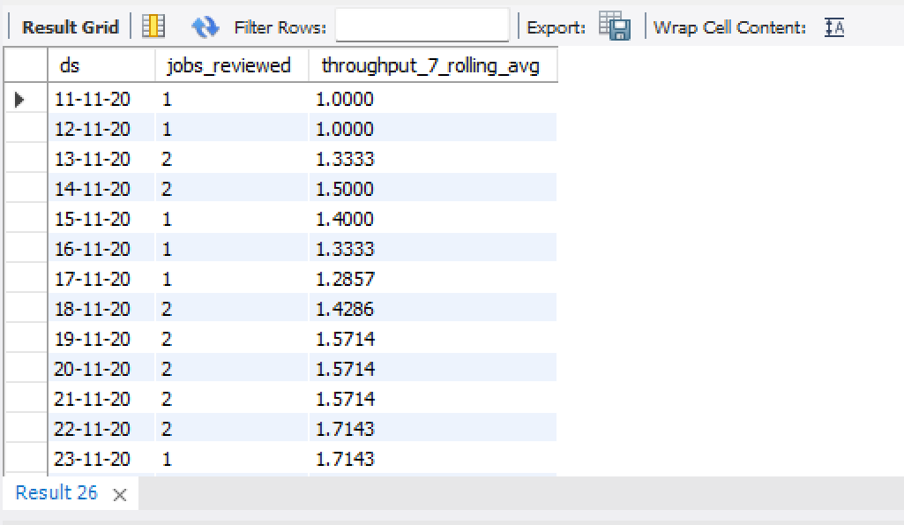
B. Throughput
It is the no. of events happening per second
Your task: Let’s say the above metric is called throughput. Calculate 7 day rolling average of throughput? For throughput, do you prefer daily metric or 7-day rolling and why?
Query
SELECT ds, jobs_reviewed, AVG(jobs_reviewed)
OVER(ORDER BY ds ROWS BETWEEN 6 PRECEDING AND CURRENT ROW) AS throughput_7
FROM (SELECT ds, COUNT( DISTINCT job_id) AS jobs_reviewed
FROM job_data GROUP BY ds ORDER BY ds) a;
Result

Slide 8
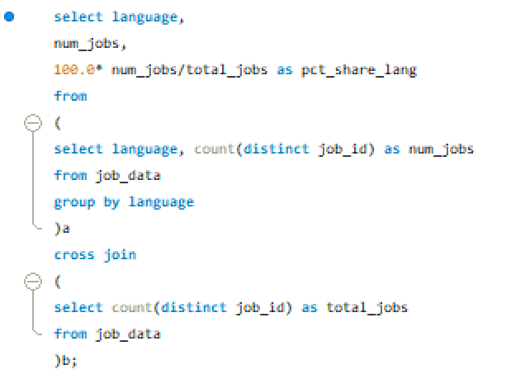
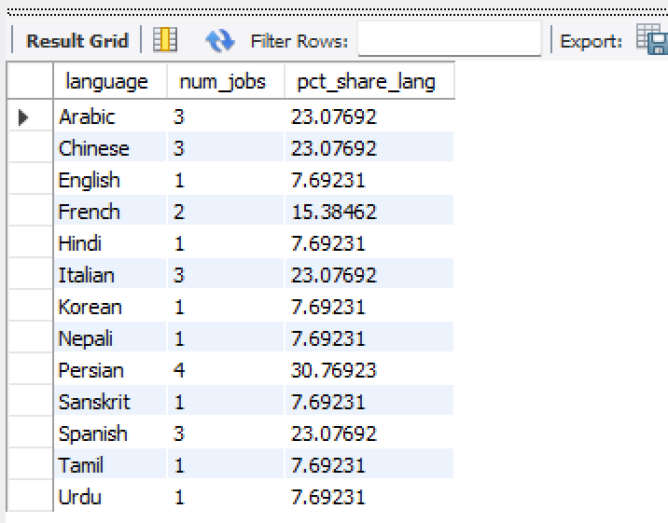
C. Percentage share of each language: Share of each language for different contents.
Your task: Calculate the percentage share of each language in the last 30 days?
QUERY
OUTYPUT
Here we can clearly see in the result that the Persian language has the highest percentage amongst the language in the last 30 days.

Slide 9
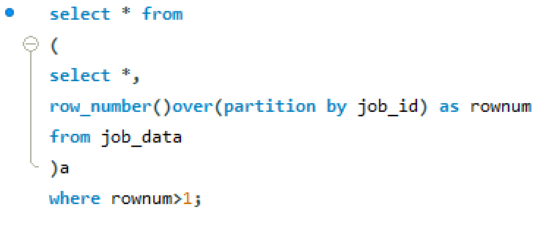
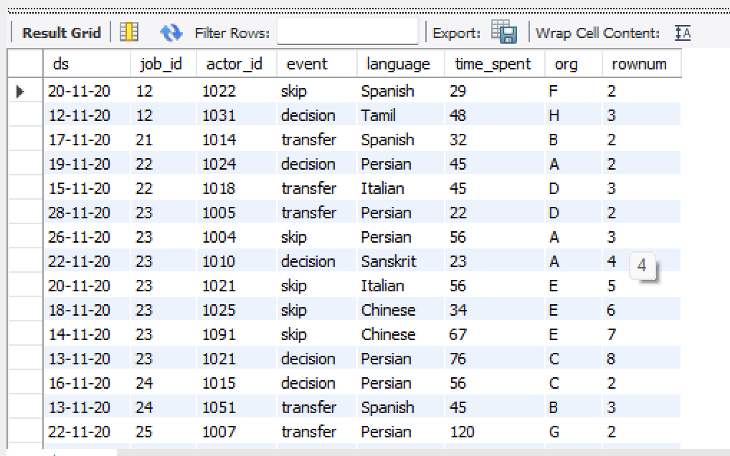
D. Duplicate rows: Rows that have the same value present in them
Your task: Let’s say you see some duplicate rows in the data. How will you display duplicates from the table?
QUERY
OUTYPUT

Slide 10
Case Study 2 (Investigating metric spike)
The structure of the table with the definition of each column that you must work on is present in the project image
Table-1: users This table includes one row per user, with descriptive information about that user’s account.
Table-2: events This table includes one row per event, where an event is an action that a user has taken. These events include login events, messaging events, search events, events logged as users progress through a signup funnel, events around received emails.
Table-3: email_events This table contains events specific to the sending of emails. It is similar in structure to the events table above.

Slide 11
User Engagement: To measure the activeness of a user. Measuring if the user finds quality in a product/service.
Your task: Calculate the weekly user engagement?
Query
select extract(week from occurred_at) as num_week,
count(distinct user_id) as no_of_distinct_user
from tutorial.yammer_events
group by num_week;

Slide 12
User Growth: Amount of users growing over time for a product.
Your task: Calculate the user growth for product?
select year, num_week, num_active_users,
sum(num_active_users) over(order by year, num_week rows between unbounded preceding and current row)
as cumm_active_users
from
(select
extract(year from a.activated_at) as year,
extract(week from a.activated_at)as num_week,
count(distinct user_id) as num_active_users
from tutorial.yammer_users a
where state='active'
group by year, num_week
order by year, num_week
)a;

Slide 13
Weekly Retention: Users getting retained weekly after signing-up for a product.
Your task: Calculate the weekly retention of users-sign up cohort?
select count(user_id),
sum(case when retention_week = 1 then 1 else 0 end) as per_week_retention
from
(
select a.user_id,
a.sign_up_week,
b.engagement_week,
b.engagement_week - a.sign_up_week as retention_week
from
(
(select distinct user_id, extract(week from occured_at) as sign_up_week
from tutorial.yammer_events
where event_type = 'signup_flow'
and event_name = 'complete_signup'
and extract(week from occured_at)=18)a
left join
(select distinct user_id, extract(week from occured_at) as engagement_week
from tutorial.yammer_events
where event_type = 'engagement')b
on a.user_id = b.user_id
)
group by user_id
order by user_id;

Slide 14
Weekly Engagement: To measure the activeness of a user. Measuring if the user finds quality in a product/service weekly.
Your task: Calculate the weekly engagement per device?
select
extract(year from occured_at) as year_num,
extract(week from occured_at) as week_num,
device,
count(distinct user_id) as no_of_users
from tutorial.yammer_events
where event_type = 'engagement'
group by 1,2,3
order by 1,2,3;

Slide 15
Email Engagement: Users engaging with the email service.
Your task: Calculate the email engagement metrics?
select
100.0 * sum(case when email_cat = 'email_opened' then 1 else 0 end)
/sum(case when email_cat = 'email_sent' then 1 else 0 end)
as email_opening_rate,
100.0 * sum(case when email_cat = 'email_clicked' then 1 else 0 end)
/sum(case when email_cat = 'email_sent' then 1 else 0 end)
as email_clicking_rate
from
(
select *,
case when action in ('sent_weekly_digest', 'sent_reengagement_email')
then 'email_sent'
when action in ('email_open')
then 'email_opened'
when action in ('email_clickthrough')
then 'email_clicked'
end as email_cat
from tutorial.yammer_events
)a;

Slide 16
RESULT
By performing analysis on the job data and user engagement and growth data, we were able to answer several questions asked by different departments of the company. We calculated the number of jobs reviewed per hour per day for November 2020, the 7-day rolling average of throughput, the percentage share of each language in the last 30 days, weekly user engagement, user growth, weekly retention of users-sign up cohort, weekly engagement per device, and email engagement metrics. Our findings and insights were presented in a report, which provided valuable information for improving the company's operations and predicting future growth.

Slide 17

Thank you
Pintu kumar Kushwaha
pkmansarowar@gmail.com

